Slide 1

FoodBot — AI-powered Food Ordering Assistant
Raise Hackathon — Prosus Track
Team: Raise Hackathon Team

Slide 2

Problem Statement
Ordering food is often frustrating and time-consuming.
Users struggle to discover good restaurants quickly and conversationally.
Need for a seamless, intelligent, conversational ordering experience.

Slide 3

Our Solution — FoodBot
An AI-powered chatbot that orders food effortlessly. • Location-based suggestions • Natural conversation flow • Smart memory and recommendations.

Slide 4

Key Features
🔍 Location Normalization (LLM-powered) 🌟 Top restaurant search (SerpAPI) 🤝 LangChain agent orchestration 💬 Gradio UI 🧠 In-memory knowledge graph ⚡ Groq + LLaMA3 for fast reasoning.

Slide 5

Architecture Overview
• Modular design using LangChain • Agent orchestrates tools and logic • Location normalization, restaurant search, and menu tools • Gradio UI for user interaction

Slide 6

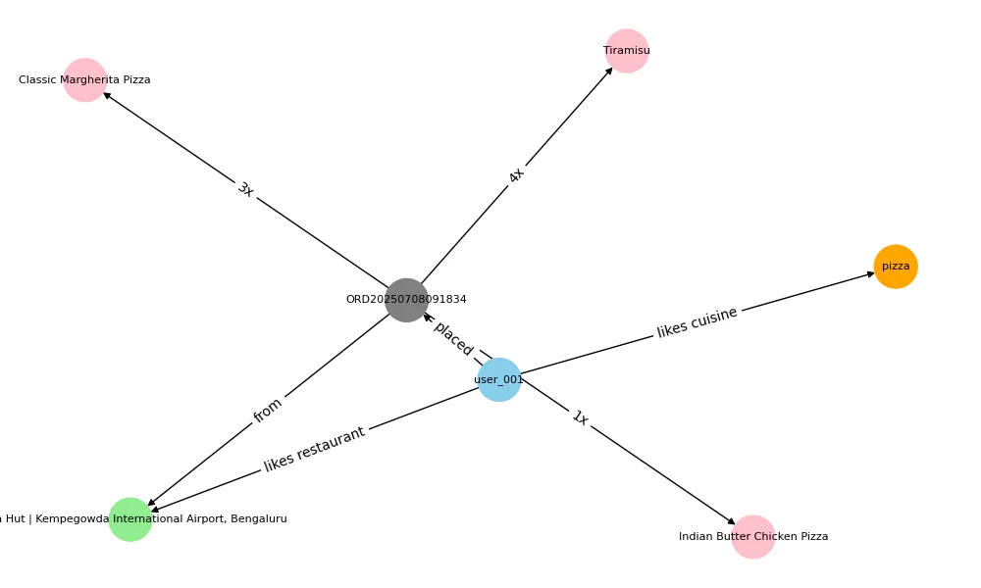

Slide 7
Conversation Flow
Smooth natural language flow: Greet user → Ask location → Suggest restaurants → Show menu → Update cart → Checkout and confirm order.

Slide 8
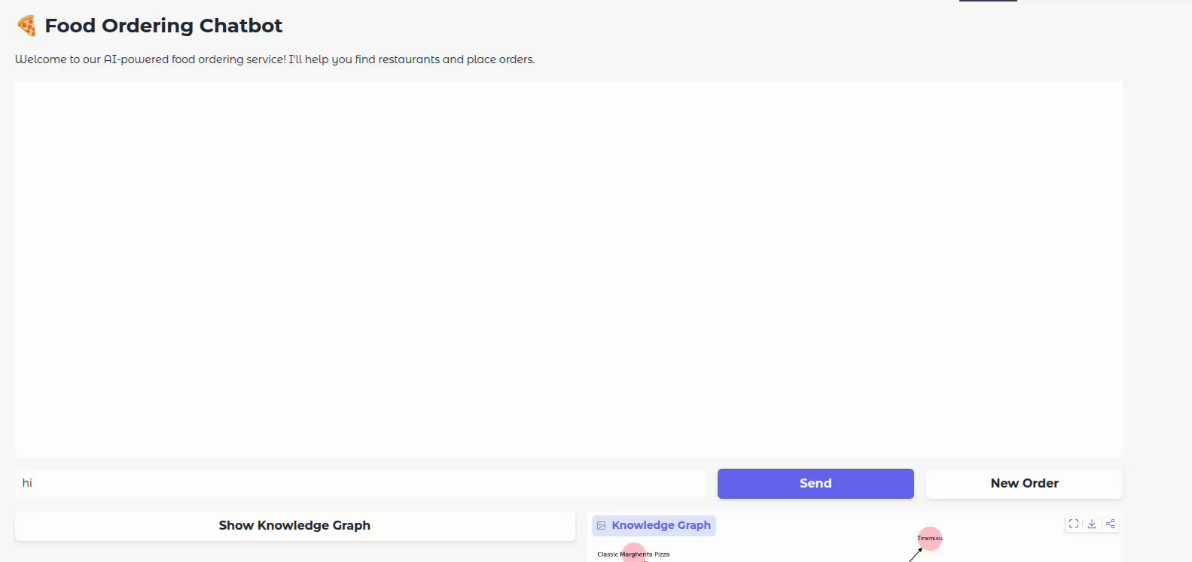

Slide 9
Tech Stack
• Python 3.10 • LangChain • Groq API + LLaMA3 • SerpAPI • Gradio • NetworkX (knowledge graph) • Deployment: Hugging Face Spaces.

Slide 10
Live Demo
Try it live! (https://huggingface.co/spaces/Ashwath-Shetty/food-ordering-bot)

Slide 11
Future Improvements
• WhatsApp/Twilio integration for confirmations • Advanced menu retrieval and structured scraping • Asynchronous execution • Persistent user memory • Personalized recommendations based on history.

Slide 12
Challenges & Learnings
• Menu data inconsistencies • API rate limits • Fine-tuning conversational flows • Balancing personalization with privacy.

